Slide 1
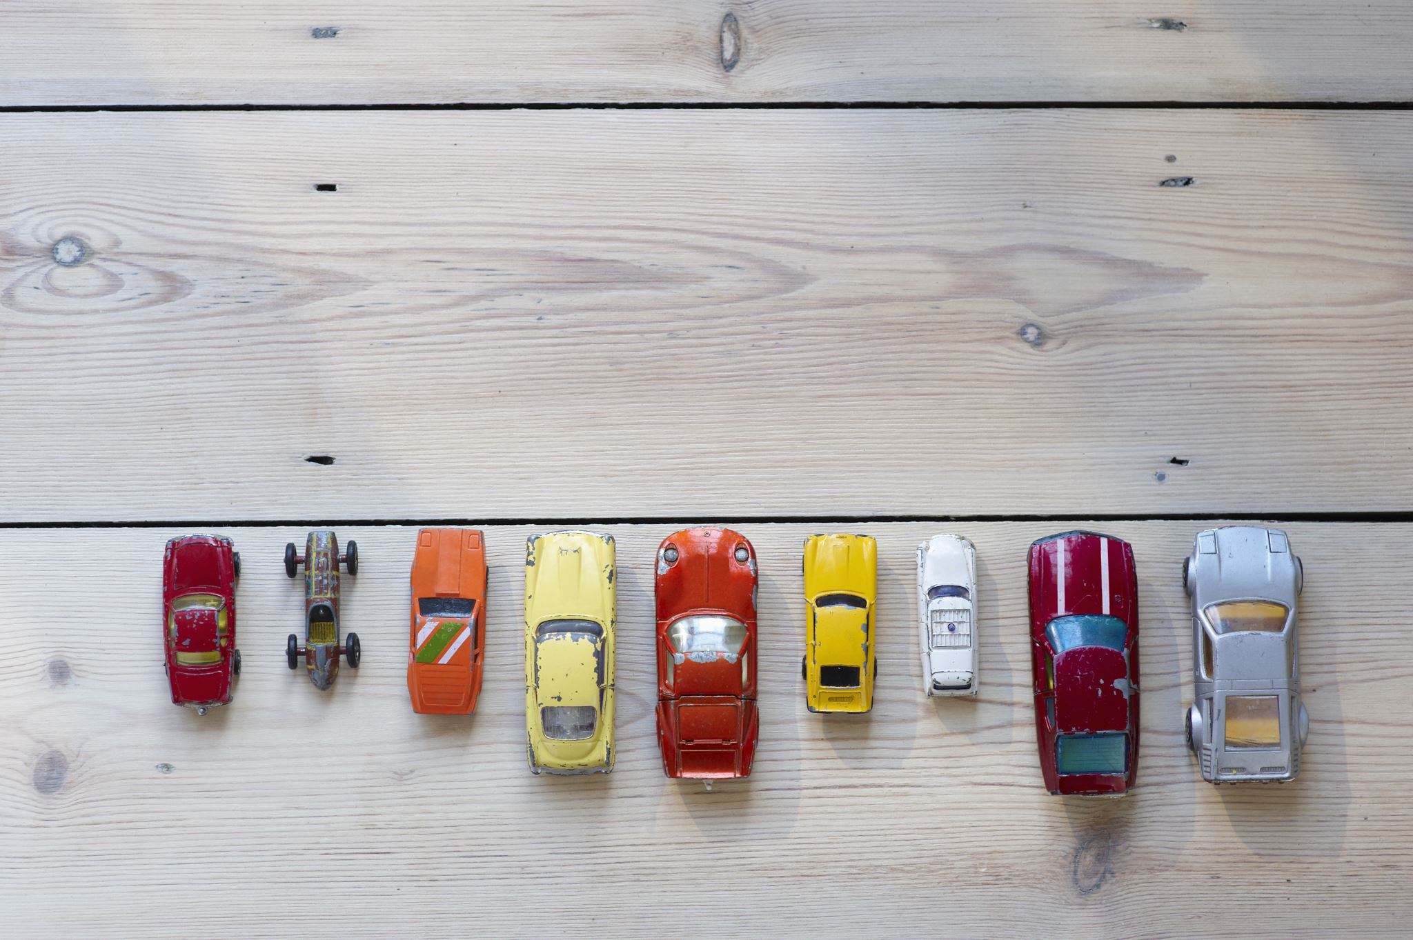
Australian Vehicle Trends - Data Visualization

Slide 2

Project Description
Looking at recent vehicle listing data in Australia, we aim to perform exploratory data analysis to determine relationships between different variables and find trends in vehicle sales.

Slide 3



Meet the team
Anrie Santos
Dominik F
Husna Nasution
Q1: How does car price vary by location and location average income?
Q2: How much does engine size (engine volume and number of cylinders) affect fuel consumptions?
Q3: What are the dominant vehicle brands and types in the Australian market?

Slide 4
Research Question
Q1: How does car price vary by location and location average income?
Datasets:
Australian Vehicle Prices https://www.kaggle.com/datasets/nelgiriyewithana/australian-vehicle-prices/code
Average weekly ordinary time earnings, full-time adults by state, original
Australia Geo Postcode https://gist.github.com/randomecho/5020859
Anrie Santos

Slide 5
Research Question
Q2: How much does engine size (engine volume and number of cylinders) affect fuel consumptions?
Datasets:
Australian Vehicle Prices https://www.kaggle.com/datasets/nelgiriyewithana/australian-vehicle-prices/code
Dominik F

Slide 6
Research Question
Q3: What are the dominant vehicle brands and types in the Australian market?
Datasets:
Australian Vehicle Prices https://www.kaggle.com/datasets/nelgiriyewithana/australian-vehicle-prices/code
Husna Nasution

Slide 7
Task
Q1: How does car price vary by location and location average income?
Tasks:
Cleaning the datasets
ABS
Aus Vehicle Prices
Postcode Geo
Aggregate the prices of all the cars grouped by Suburb (mean, mode, median, stderr, var, sem)
Merged the datasets from the Vehicle prices (aggregated) to the Postcode Geo
Anrie Santos

Slide 8
Task
Q2: How much does engine size (engine volume and number of cylinders) affect fuel consumptions?
Tasks:
Extract float/int values of fuel consumption, engine volume and cylinder count.
Clean the data of any NaN or 0 rows for these data columns.
Create box plot analysis of fuel consumption per number of cylinders in engine.
Perform linear regression comparing engine volume to fuel consumption.
Dominik F

Slide 9
Task
Q3: What are the dominant vehicle brands and types in the Australian market?
Tasks:
Import libraries
Load csv data into dataframe
Data exploration: display the first data and check data type
Data cleaning: convert the 'Price' column to numeric type, handling potential errors
Data aggregation: groups the data by Brands and Body Type and calculate the average price
Visualisation: select top 10 brands & body types and creates bar chart and save file into png
Husna Nasution

Slide 10
Data
Q1: How does car price vary by location and location average income?
Anrie Santos

Slide 11
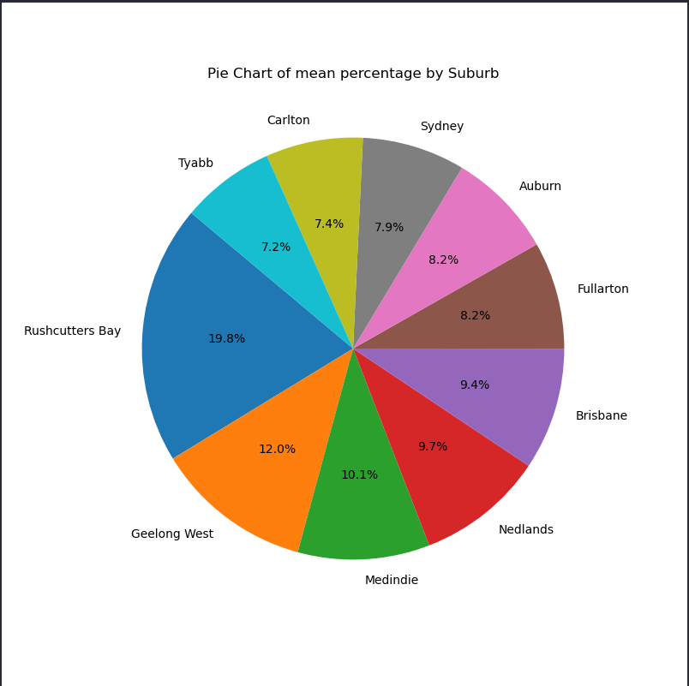
Data
Q1: How does car price vary by location and location average income?
Anrie Santos

Slide 12
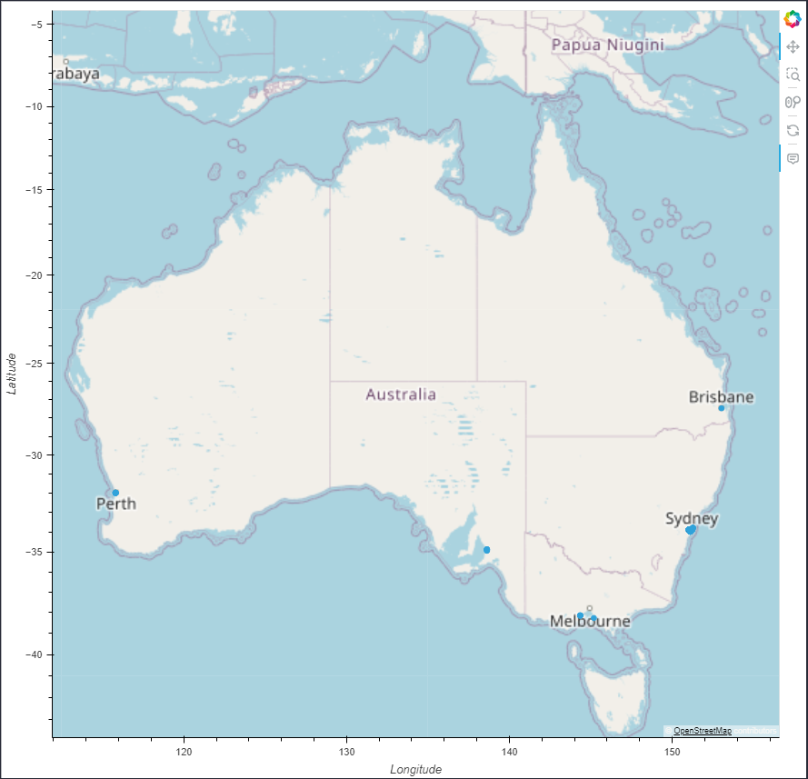
Findings
Q1: How does car price vary by location and location average income?
Findings:
Top 2 vehicle price by State are Tasmania and WA
Top 2 vehicle price by Suburb are Rushcutters Bay and Geelong West
Anrie Santos

Slide 13
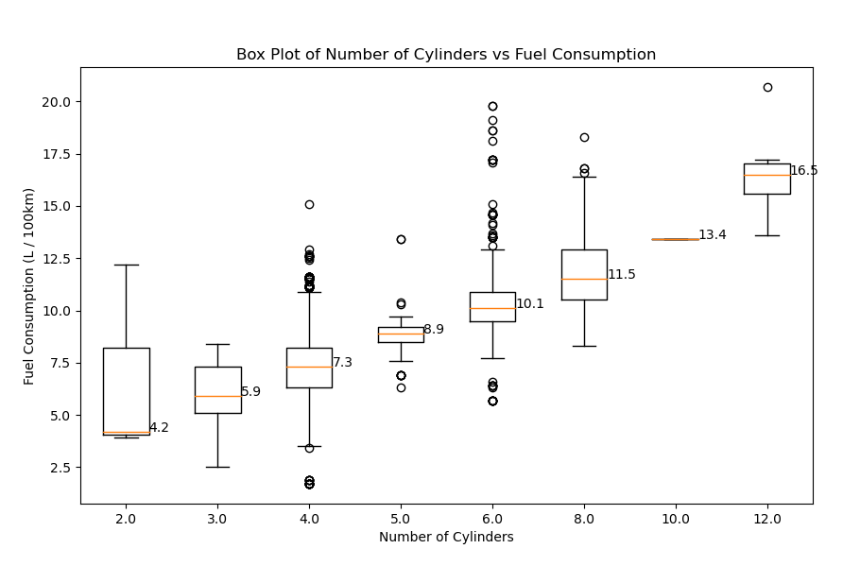
Q2: How much does engine size (engine volume and number of cylinders) affect fuel consumptions?
Findings
Dominik F
Number of data entries for 2.0 cylinders: 3
Number of data entries for 3.0 cylinders: 149
Number of data entries for 4.0 cylinders: 6121
Number of data entries for 5.0 cylinders: 344
Number of data entries for 6.0 cylinders: 918
Number of data entries for 8.0 cylinders: 316
Number of data entries for 10.0 cylinders: 1
Number of data entries for 12.0 cylinders: 6

Slide 14
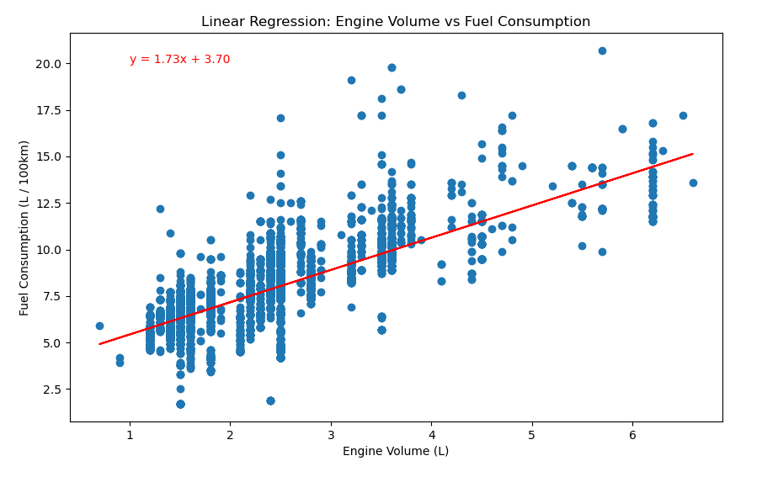
Q2: How much does engine size (engine volume and number of cylinders) affect fuel consumptions?
Data
Dominik F
Linear Regression Metrics (all to 3d.p.):
Slope Gradient: 1.733
Intercept: 3.697
R-value (Correlation coefficient): 0.746
Standard Error: 0.017

Slide 15
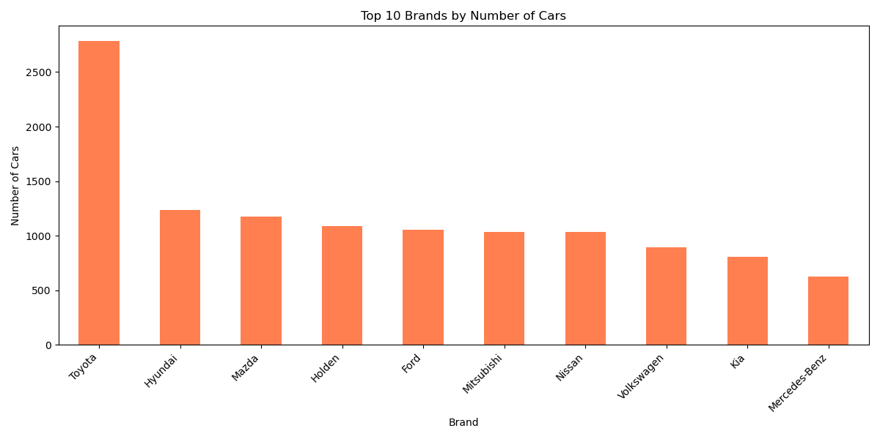
Q3: What are the dominant vehicle brands and types in the Australian market?
Data
Husna Nasution

Slide 16
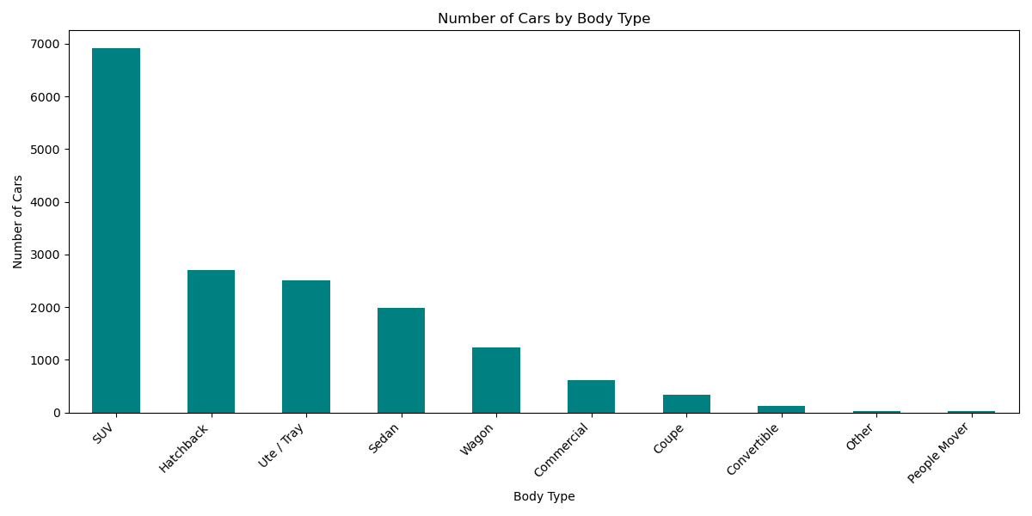
Q3: What are the dominant vehicle brands and types in the Australian market?
Data
Husna Nasution

Slide 17
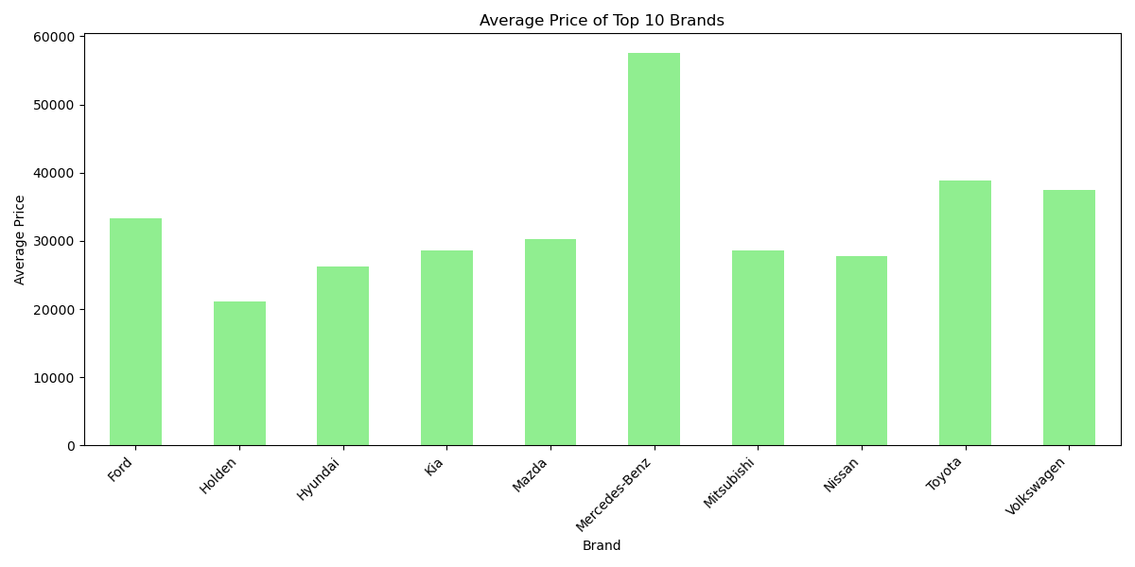
Q3: What are the dominant vehicle brands and types in the Australian market?
Data
Husna Nasution

Slide 18
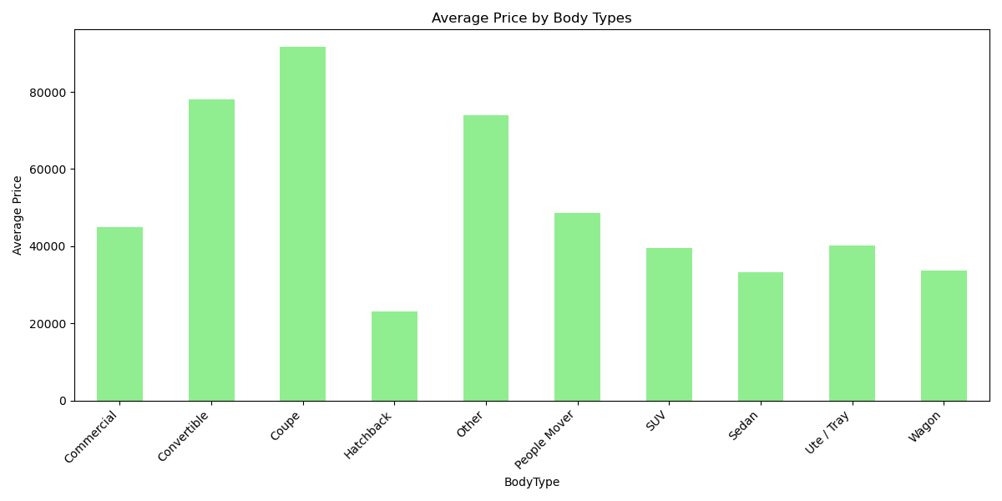
Q3: What are the dominant vehicle brands and types in the Australian market?
Findings
Husna Nasution

Slide 19
Conclusion
From our findings, the suburb with the highest average vehicle price are Rushcutters Bay and Geelong
West. The states with the highest average vehicle prices are Tasmania and Western Australia.
Engine volume is directly associated with higher levels of fuel consumption.
Average increase of 1.73L/100km per 1 L increase in engine volume.
The median fuel consumption of vehicles increases steadily as cylinder count is increased.
Toyota dominates with the highest number of cars, with 2784 cars, Toyota alone represents almost 17% of the total 16733 cars in the dataset.
SUVs regardless of their brands, are the most popular body type by a significant margin, accounting for 41.27% (over 6900 cars).

Slide 20
Thank you

